Slide 1
Development and Application of GPT

Slide 2
Introdution
Name: Shihan Wu
Major: Computer Science and Technology
Topic: GPT

Slide 3
GPT-1
GPT-2
Development
GPT-3
GPT-4

Slide 4
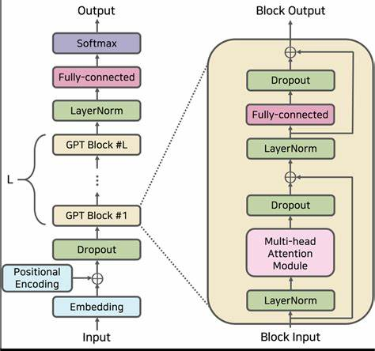
Development
GPT-1
Relatively small scale
Continuous text generate ability

Slide 5
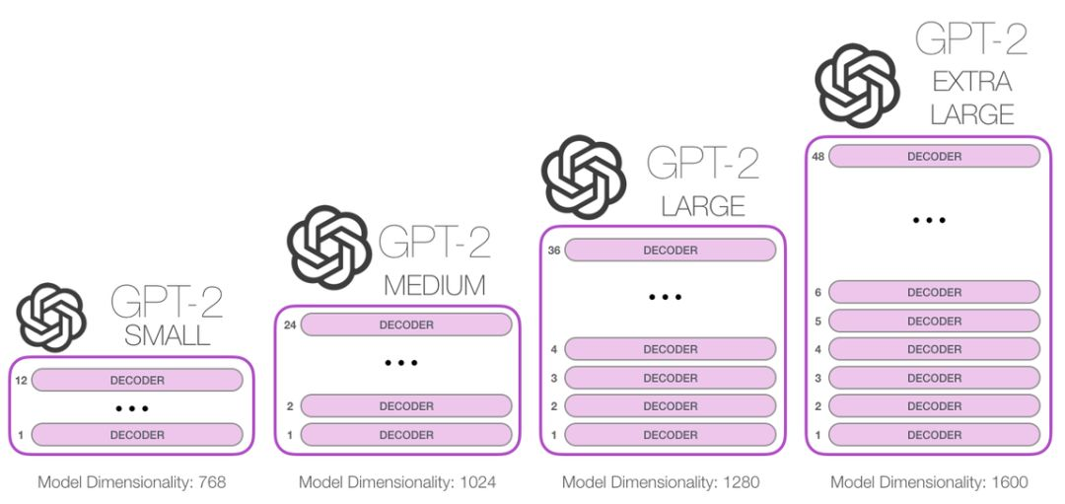
Development
Larger parameters
More diverse datasets
GPT-2

Slide 6
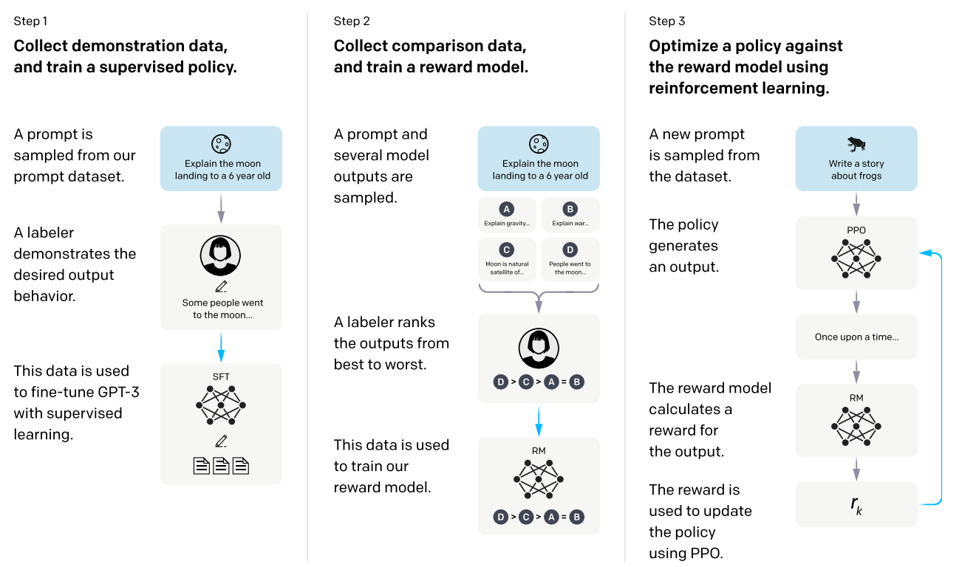
Development
GPT-3
A thousand times more parameters
Based on GPT-3, ChatGPT, CodeX, etc.

Slide 7
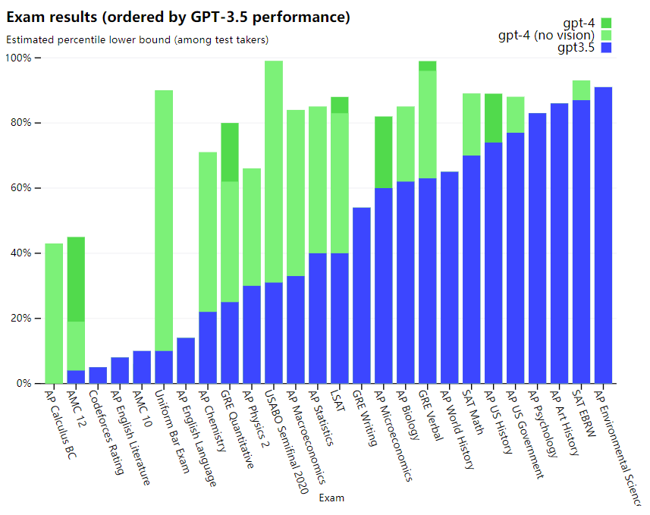
Development
GPT-4
Multi-modal capabilities
Complex reasoning
Accept image input

Slide 8

Applications
Natural Language Generation
Code Generation
Dialog System
Image Analysis
Text Summary and Translation
Content Production

Slide 9
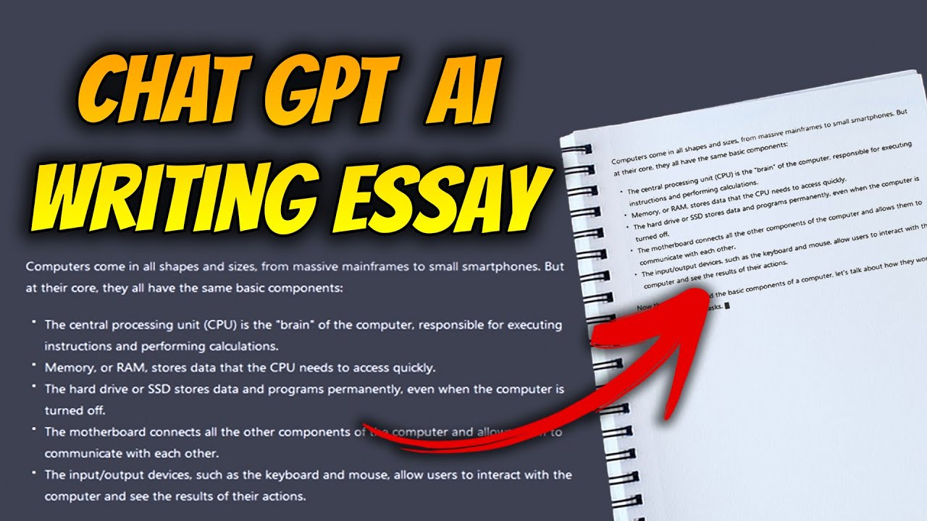
Applications
Natural Language Generation
Generate natural and fluent text
Including articles, stories and poems

Slide 10
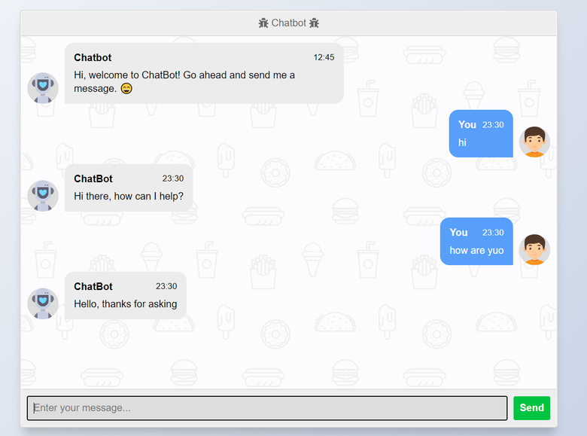
Applications
Dialog System
Hold conversations with users.
Answer questions.
Offer suggestions

Slide 11
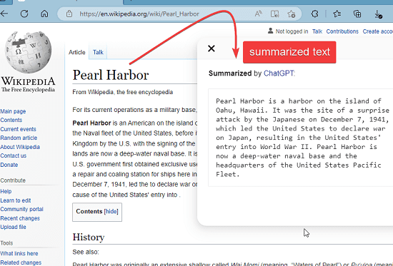
Applications
Text Summary and Translation
Extract key information from long texts
Generate summaries
Translate text from one language to another

Slide 12
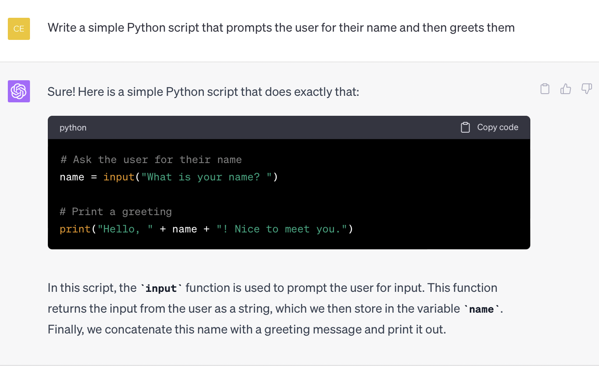
Applications
Code Generation
Automatically write code that conforms to specifications and logic

Slide 13
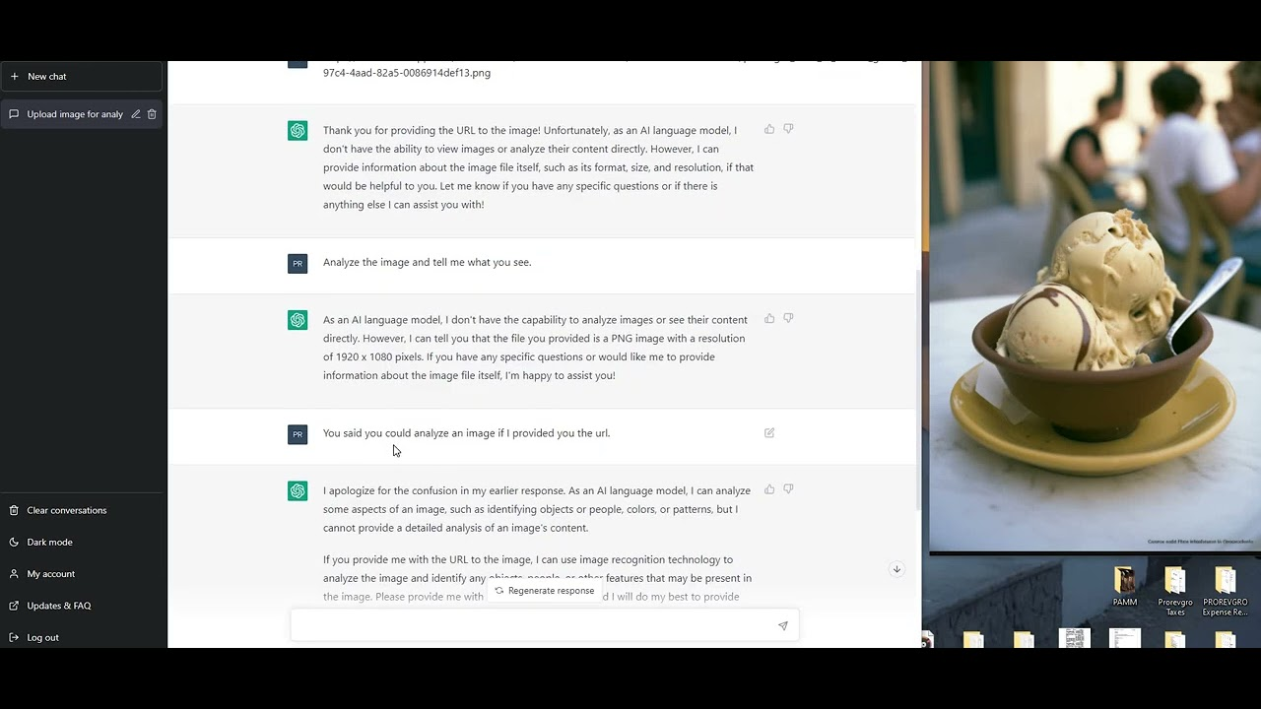
Applications
Image Analysis
Accept images as input and generate titles
Classifications
Analyses that show the content and features

Slide 14
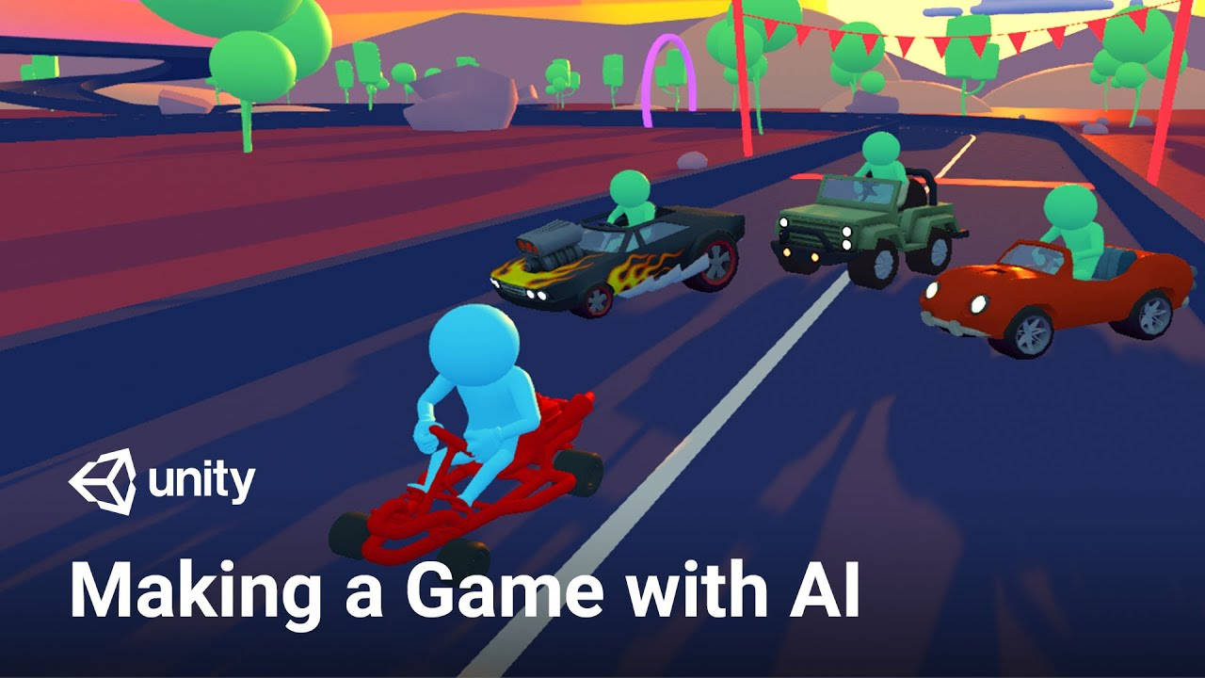
Applications
Content Production
Generate various types of content
such as articles, abstracts, reviews, poems, lyrics, stories, games, etc

Slide 15
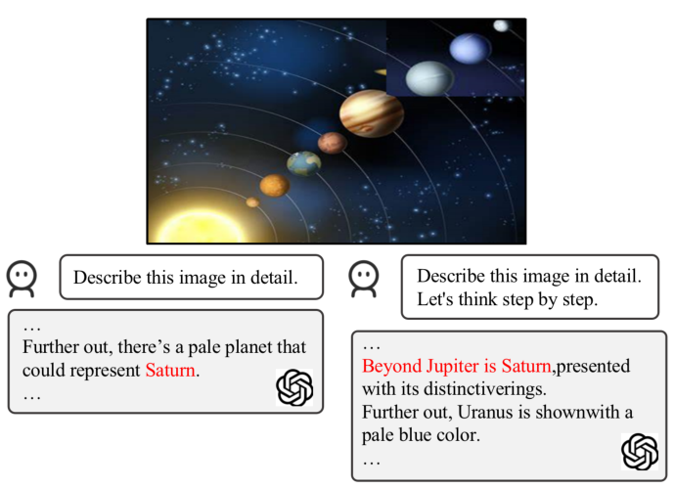
Shortages
Produces false predictions
Generate biased responses

Slide 16
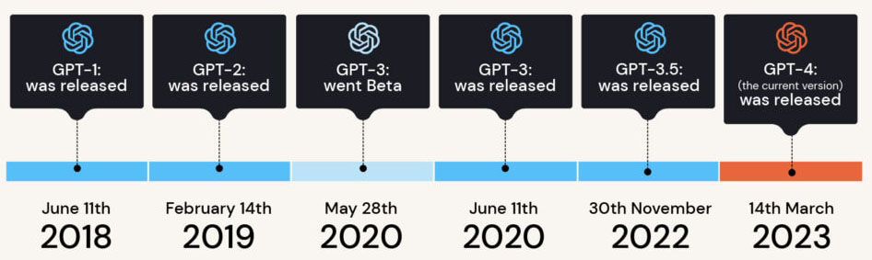
Ending
GPT Timeline

Slide 17
References
Radford A, Narasimhan K, Salimans T, et al. Improving language understanding by generative pre-training[J]. 2018.
Radford A, Wu J, Child R, et al. Language models are unsupervised multitask learners[J]. OpenAI blog, 2019, 1(8): 9.
Brown T, Mann B, Ryder N, et al. Language models are few-shot learners[J]. Advances in neural information processing systems, 2020, 33: 1877-1901.
Ouyang L, Wu J, Jiang X, et al. Training language models to follow instructions with human feedback[J]. Advances in Neural Information Processing Systems, 2022, 35: 27730-27744.
Cui C, Zhou Y, Yang X, et al. Holistic analysis of hallucination in gpt-4v (ision): Bias and interference challenges[J]. arXiv preprint arXiv:2311.03287, 2023.

